Slide 1
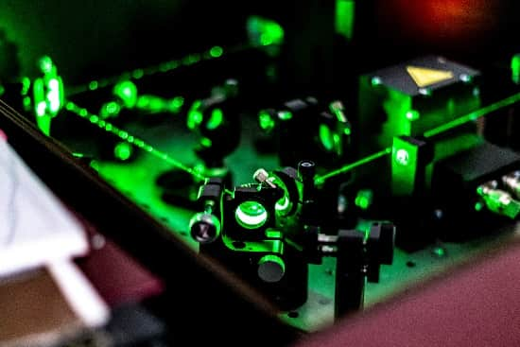

Fibre Optics and Photonics
for Harsh Environments
iAero – 31st July 23
2023 © AVoptics Ltd. All rights reserved.

Slide 2
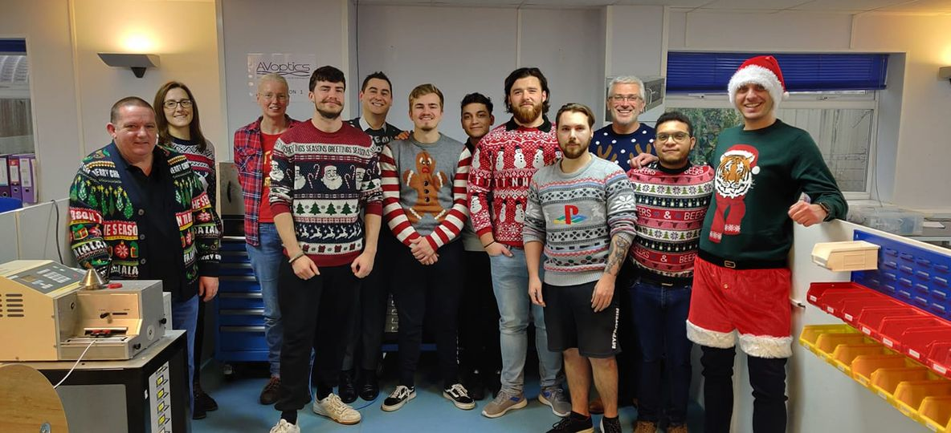
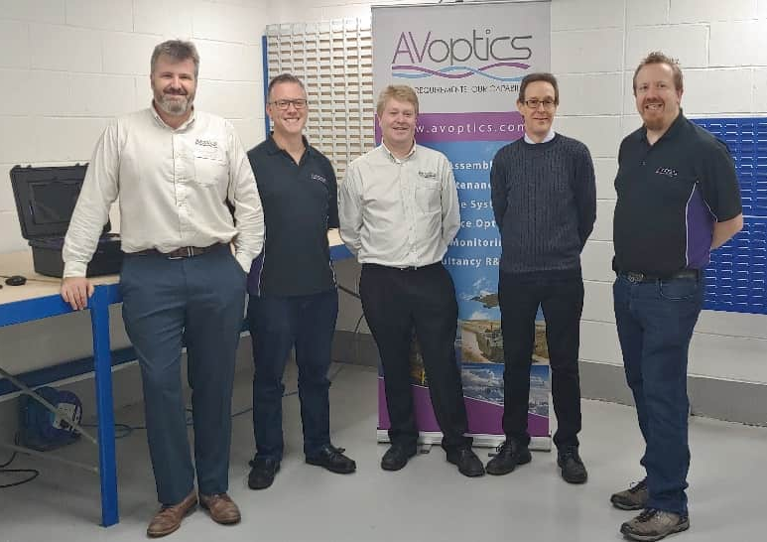
Background
Formed in 2005, AVoptics Limited was founded to address the issues of supporting Fibre Optic Systems in Harsh Environments
Employs 'world class’ personnel:
  Research & Design
      Ex BAE Systems & Leonardo Helicopters
      Four PhD’s
      Internationally recognised within Aerospace.
  Production personnel
      Strong staff retention
      All trained to 'Aerospace' standards – AS5602 & ARINC 807
      Friendly Team
Key revenue areas:
  Harness Manufacture
  Supportability Tooling/Kits
  Contract Research / Training
  Novel GSE Products

Slide 3

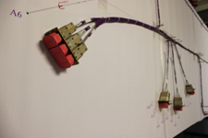
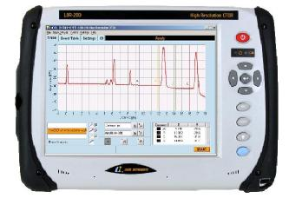
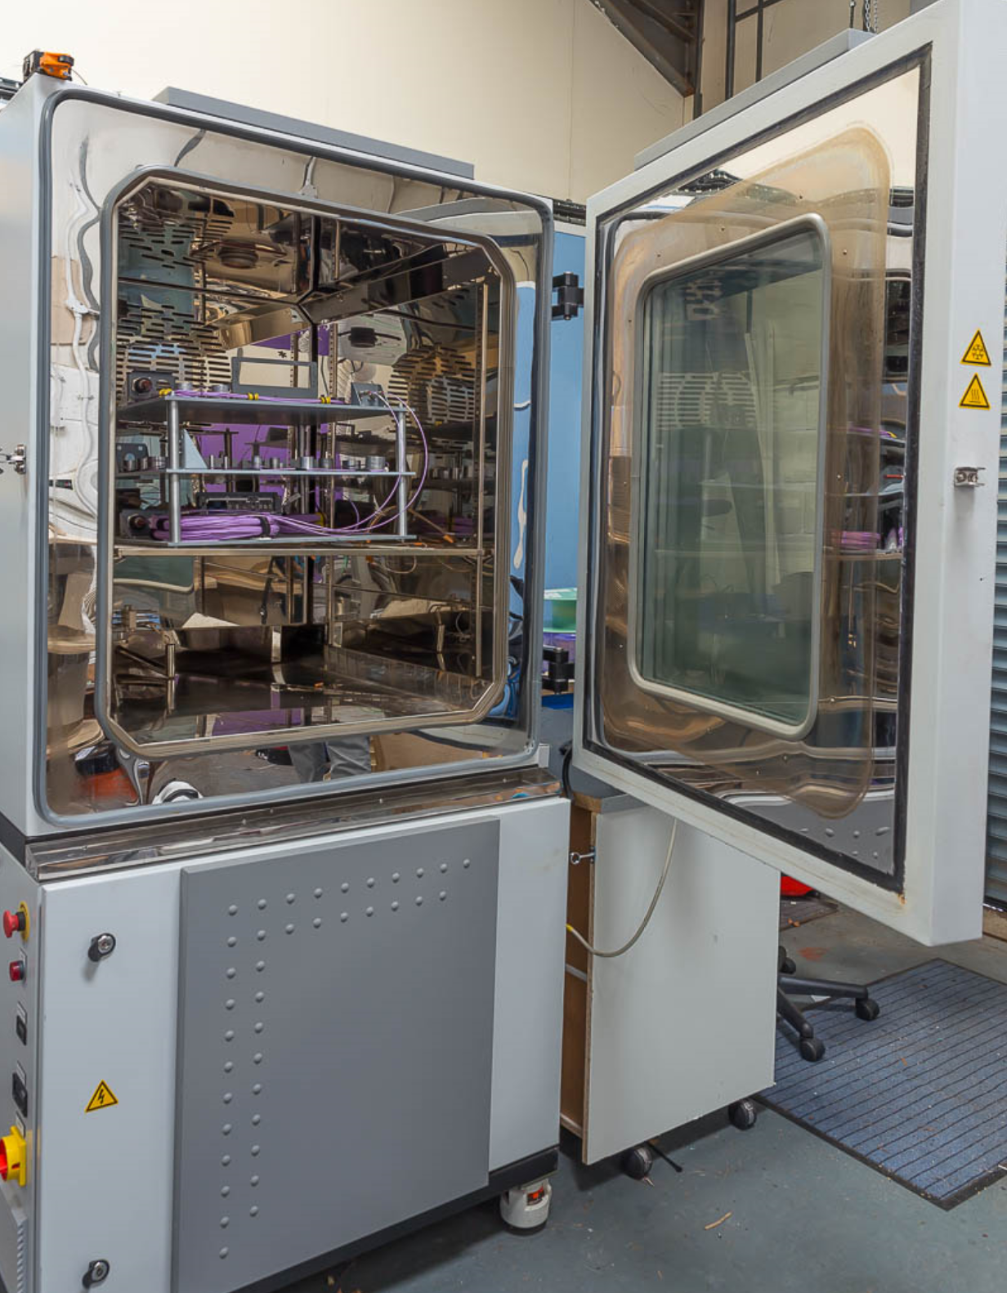
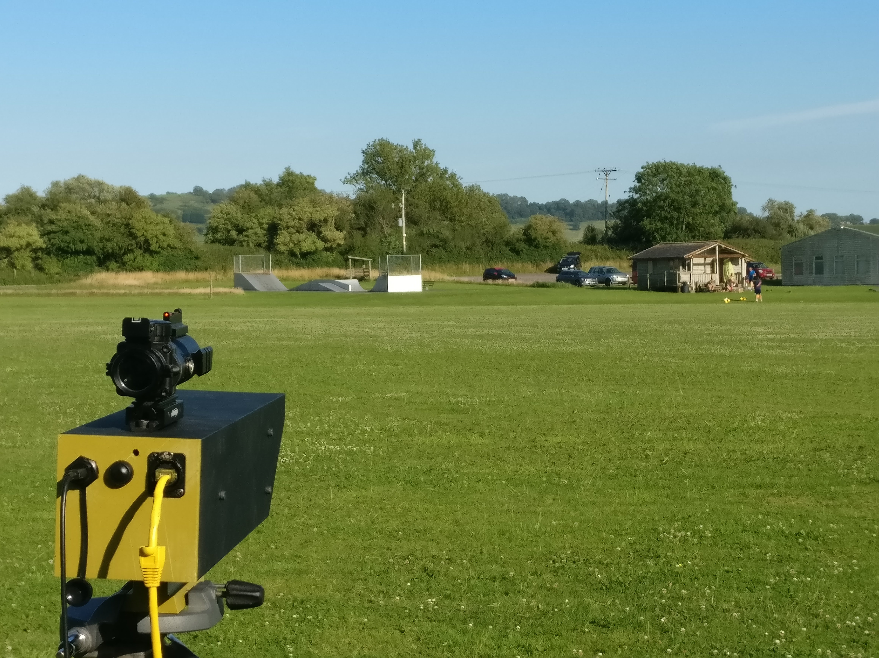
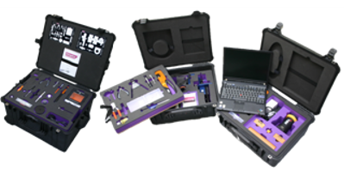

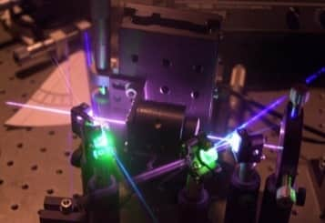
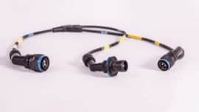
Brief History of AVoptics Limited
Harness Manufacture
Starts
Growth in Ground Support Equipment
Cwmbran Office Opened
New Products
Free Space
Optics Development
AVoptics
Founded
2005
2007
2008
2010
2012
2015
2018
2020
2024
First AVoptics Dedicated Premises
Launch of AVliteCure™ and AVliteRepair™
First AVoptics moves to Limber Road
AS9100 Achieved
AVoptics LightWorks R&D Team formed
Awarded GD AJAX
Leonardo – Cable Assy
Leonardo – Electrical test

Slide 4
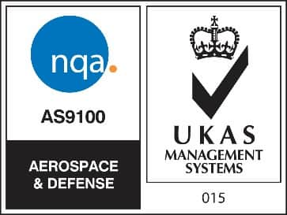


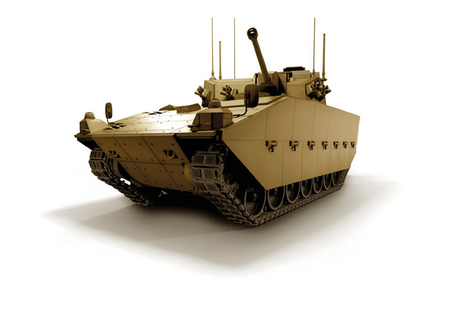

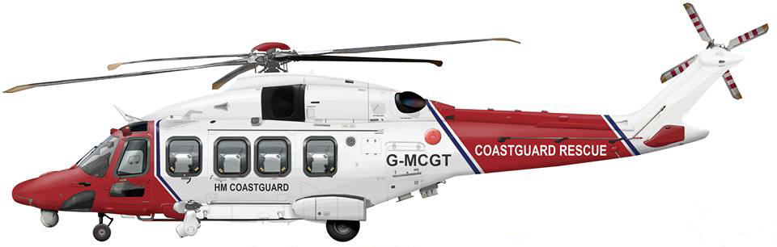



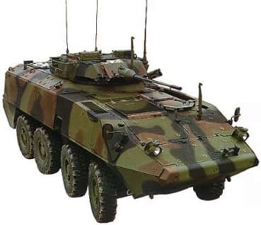
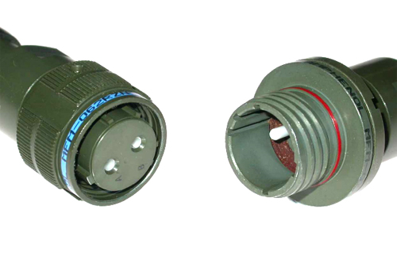
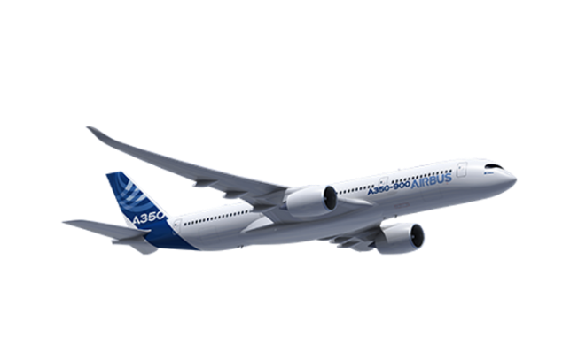




Accreditations
AS9100 Rev D (cert No 27224)
BS EN ISO 9001:2015 (cert No 27224)
Key Supplier to:

Slide 5



Vision statement
To be a globally recognised, profitable and respected company supplying high quality Photonic Solutions for harsh environments.
2023 © AVoptics Ltd. All rights reserved.

Slide 6
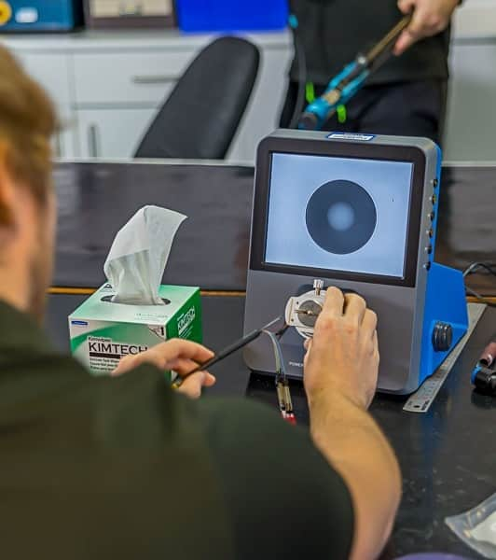
Production Activities
To provide a world leading harness/cable assembly manufacturing capability for harsh environments
2023 © AVoptics Ltd. All rights reserved.

Slide 7
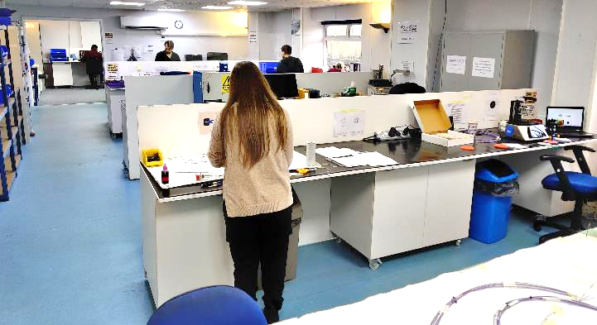
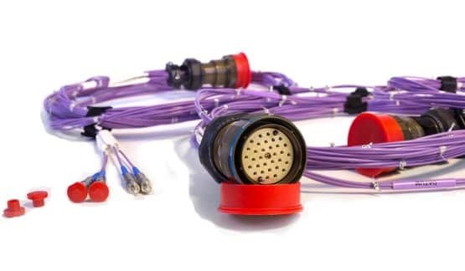
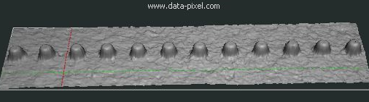
Fibre Optic and Electrical Cables;
Production Capability
AVoptics has its own fully equipped in house production facility floor (100sq/m) all within AS9100 scope.
Has significant tooling and test equipment to meet a diverse set of application:
Capability to deliver:
  Cable Assemblies
  Rig Build
  Electronic Assy (low volume build)
  RF Assy (shared with partner)
Build to Print or full design and manufacture service.
Equipment to cater for the unusual.
  Polishing -angled
  Fibre / ferrule sizes
  End face Geometry
Full testing Capability
2023 © AVoptics Ltd. All rights reserved.

Slide 8
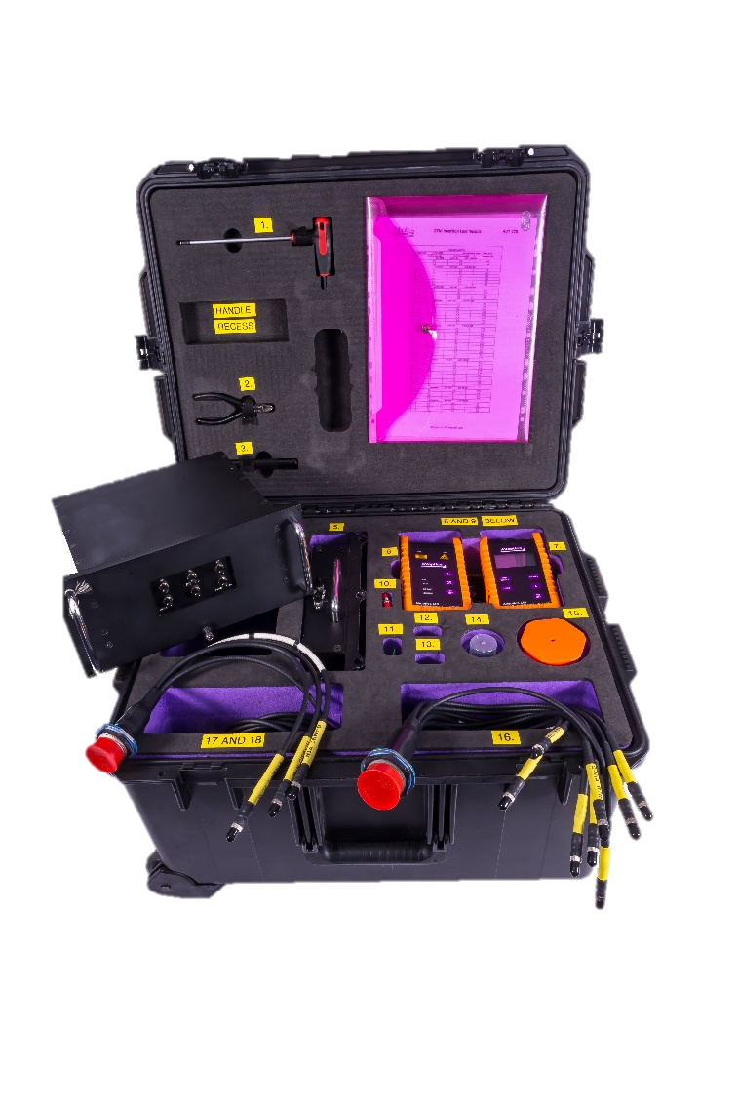
Products
2023 © AVoptics Ltd. All rights reserved.

Slide 9
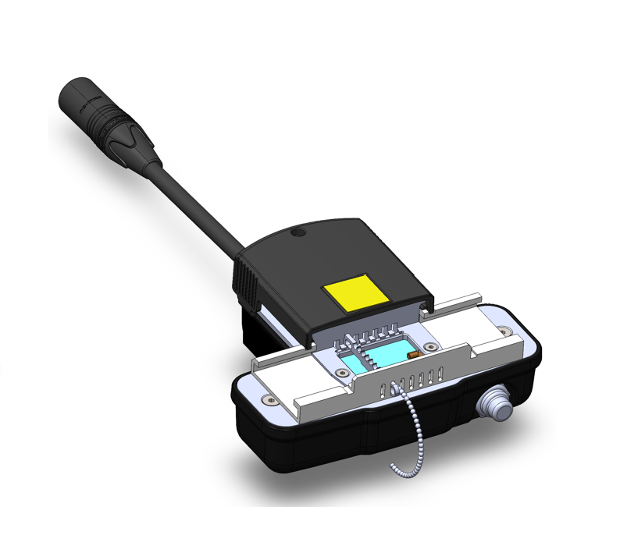

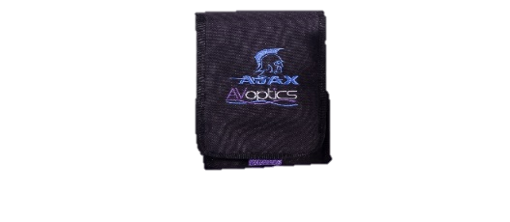
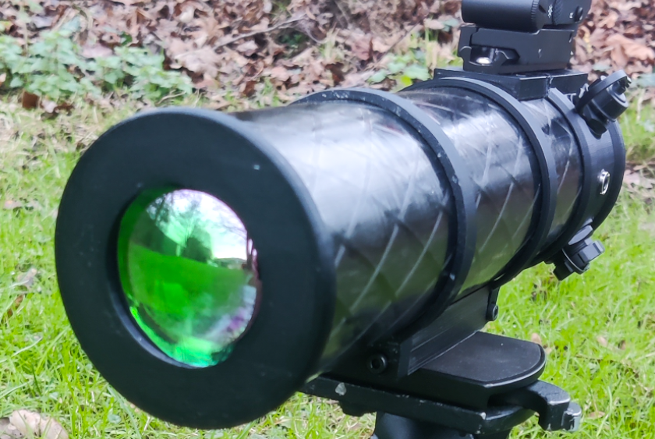
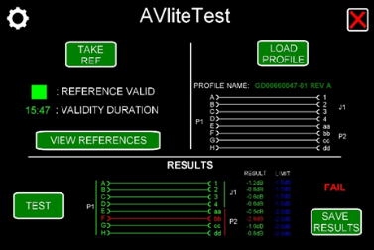
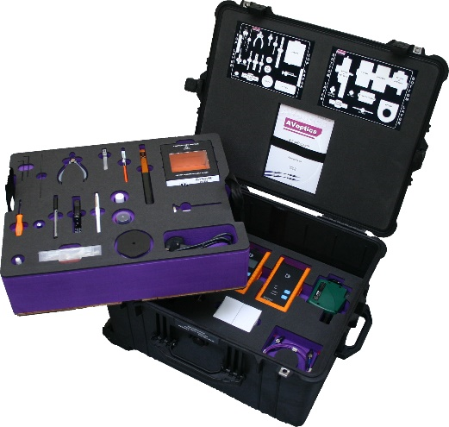
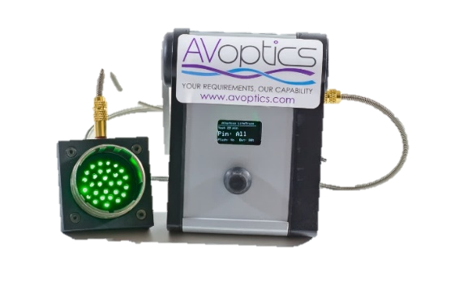
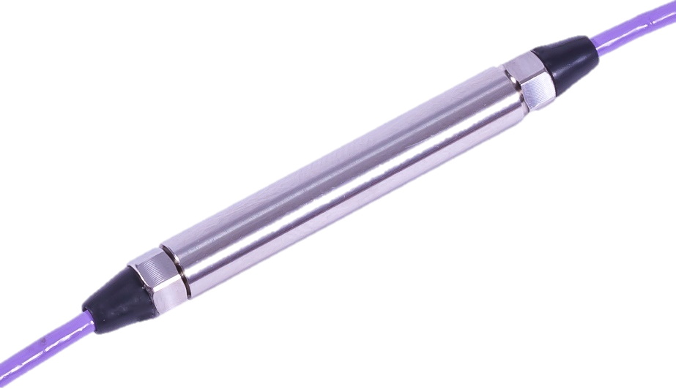
Support for Complete Life Cycle
Product / Product Development
Cleaning
Fault Finding
Repair / Re-termination
Verification/ Validation
Free Space Optics
2023 © AVoptics Ltd. All rights reserved.

Slide 10

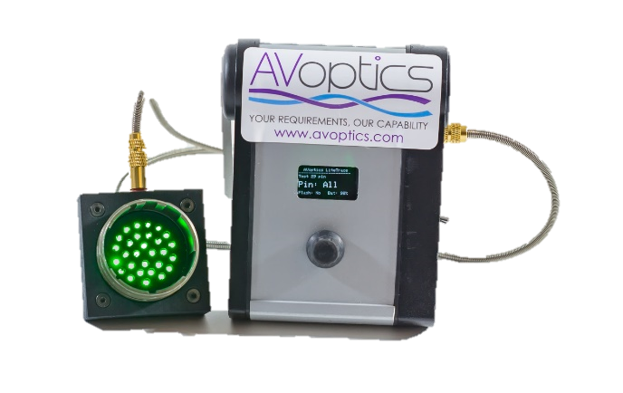

Support for Complete Life Cycle
Cleaning
Fault Finding
Repair

Slide 11
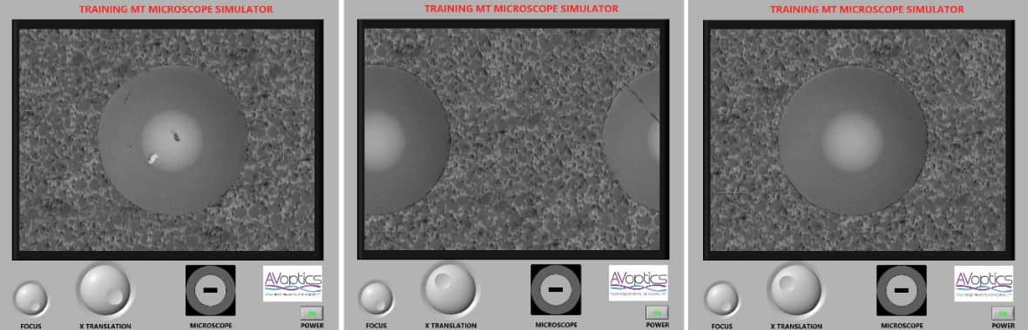
Inspection and Test
AVoptics offers inspection equipment and test kits for all fibre-optic products
Designed to enable the operator to quickly and easily perform the required inspection tasks
Customer interfaces for platform specific requirements can be designed and integrated.
  Representative Test Modules (RTMs)

Slide 12
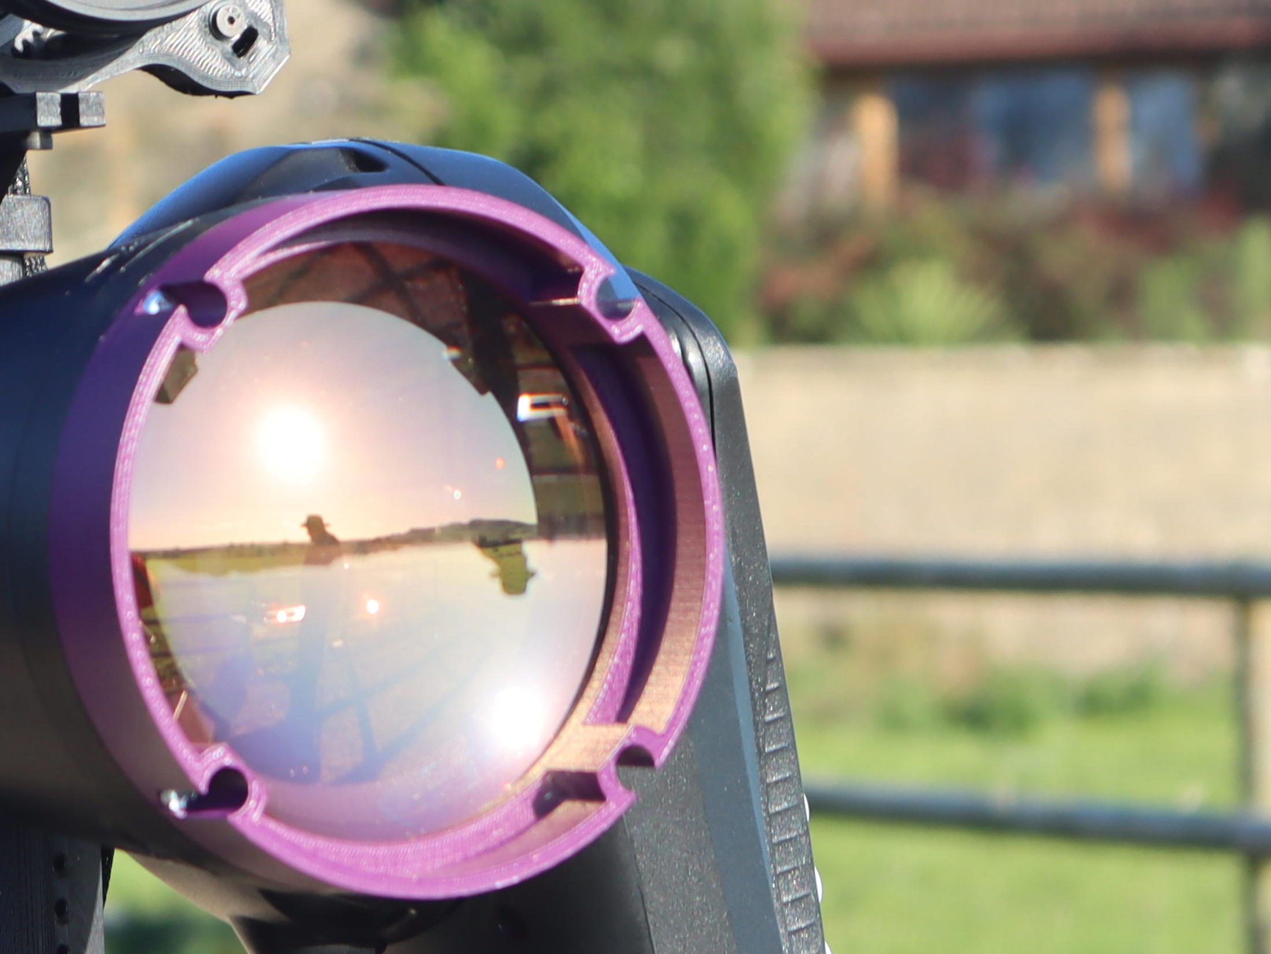
R&D and Consultancy
“LightWorks”
2023 © AVoptics Ltd. All rights reserved.

Slide 13
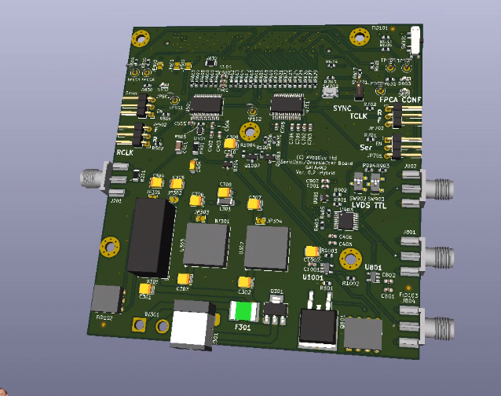
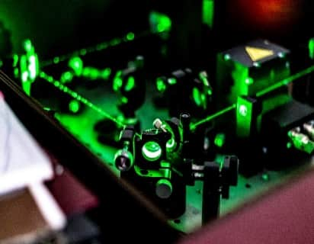

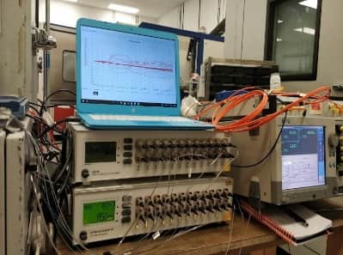
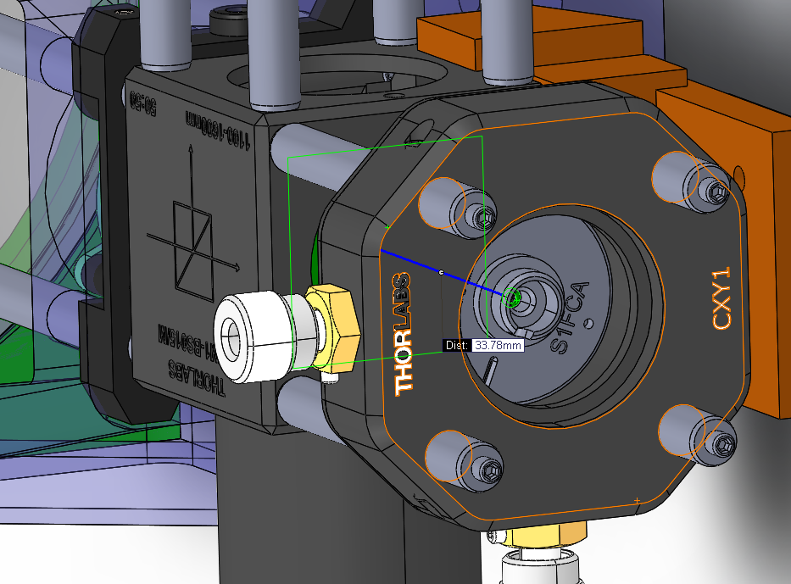
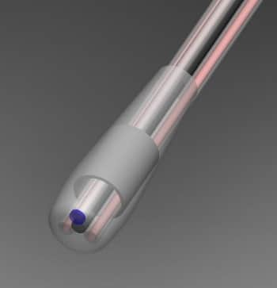


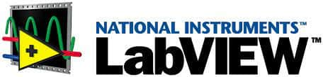
Consultancy and Testing
Highly respected Scientist & Engineers
  Free Space Optics
  Fibre Component Characterisation / Testing
  Sensing
Fully Equipped Laboratory
Modelling Tools
Environmental testing
Agile approach to R&D
2023 © AVoptics Ltd. All rights reserved.

Slide 14
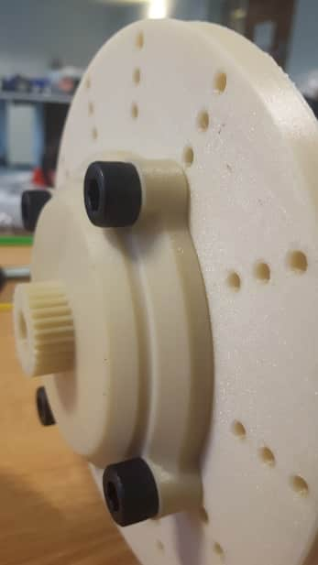
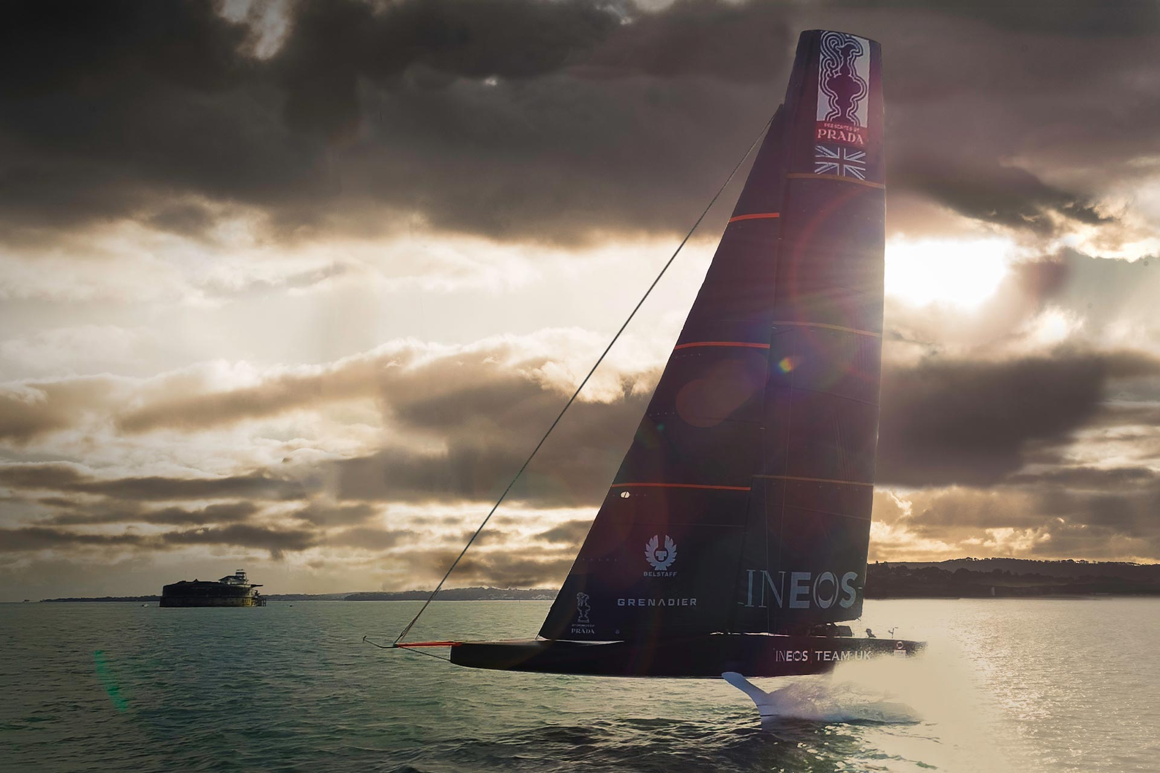
Fibre Sensing
Associated challenges:
Support with design and positioning
Interrogation and Interpretation
Protection of entry and exit points
Transmission of signal through challenging areas. (i.e. rotary couplings)
Supporting services:
Full design and prototyping services
System Design
F1
Marine
2023 © AVoptics Ltd. All rights reserved.

Slide 15


Photonic Research
Development of High Performance APDs
  Improved Signal to Noise Ratio performance for space applications
Quantum proof secure cryptography
Printed Spatial Light Modulators (SLM) non-mechanical laser beam steering and atmospheric distortion correction.
  Long-range free-space optical communications
2023 © AVoptics Ltd. All rights reserved.

Slide 16
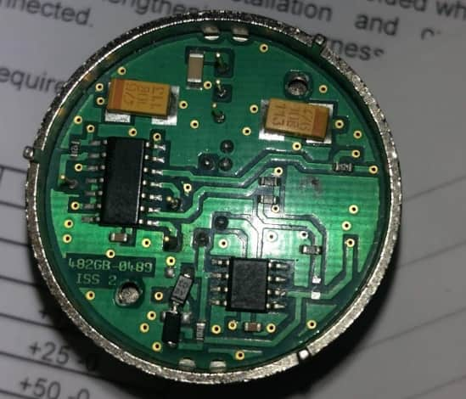
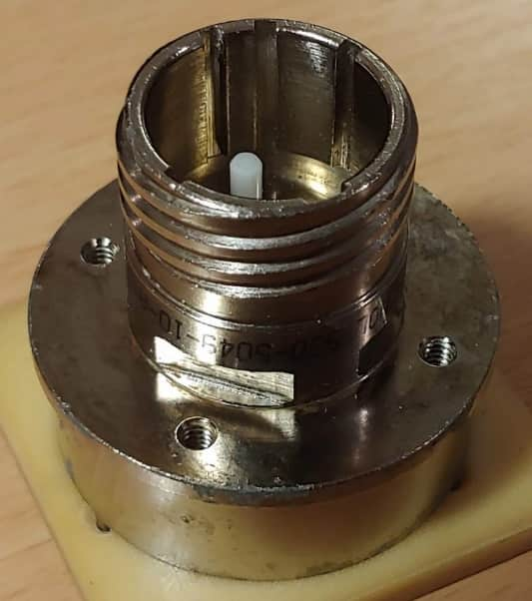
EO Signal Conversion
In house aerospace fibre optic media convertors
Custom design / form factor
Extended performance
Designed to meet customer requirements
Multiple protocols options
2023 © AVoptics Ltd. All rights reserved.

Slide 17
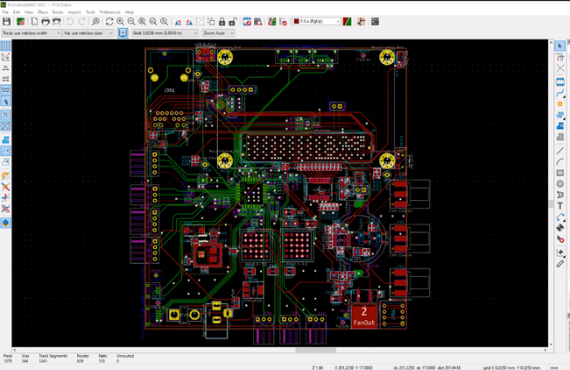
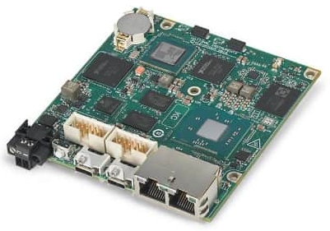
Electronics Design & FPGA Development
Development of High Speed and Low Speed Electronics
Discreet, microprocessor and FPGA experience
Experience primarily in communications and image processing

Slide 18
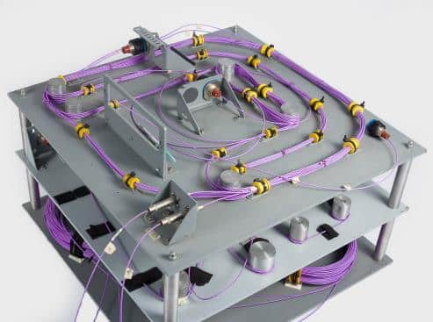
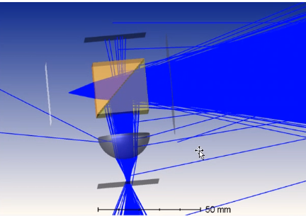

Photonics and Fibre-Optics Design Consultancy
Researchers and engineers leading the field of fibre-optics, photonics, electronics and optical systems.

Slide 19
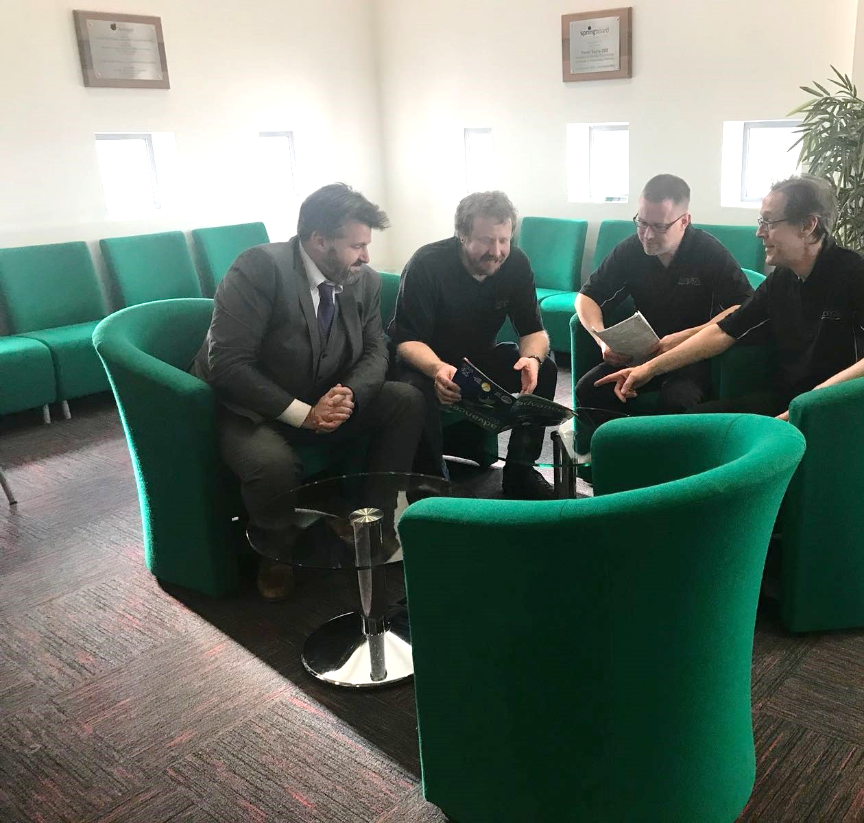
Training
World Leading Fibre Optic Training for Aerospace
2023 © AVoptics Ltd. All rights reserved.

Slide 20

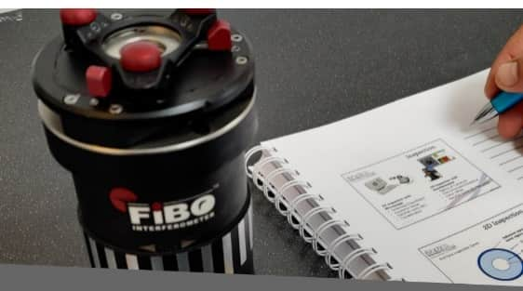
Fibre optics
Installers and Fabricators
‘Best Practice’ training – for Aerospace
AVoptics are the only company outside of North America to be registered with the ETA to offer accredited SAE5602 and ARINC 807 – Aerospace Fibre Optic training courses
https://www.eta-i.org/test_sites.html
Fundamentals
Installer
Fabricator
The UK MoD support services are now being trained
2023 © AVoptics Ltd. All rights reserved.

Slide 21
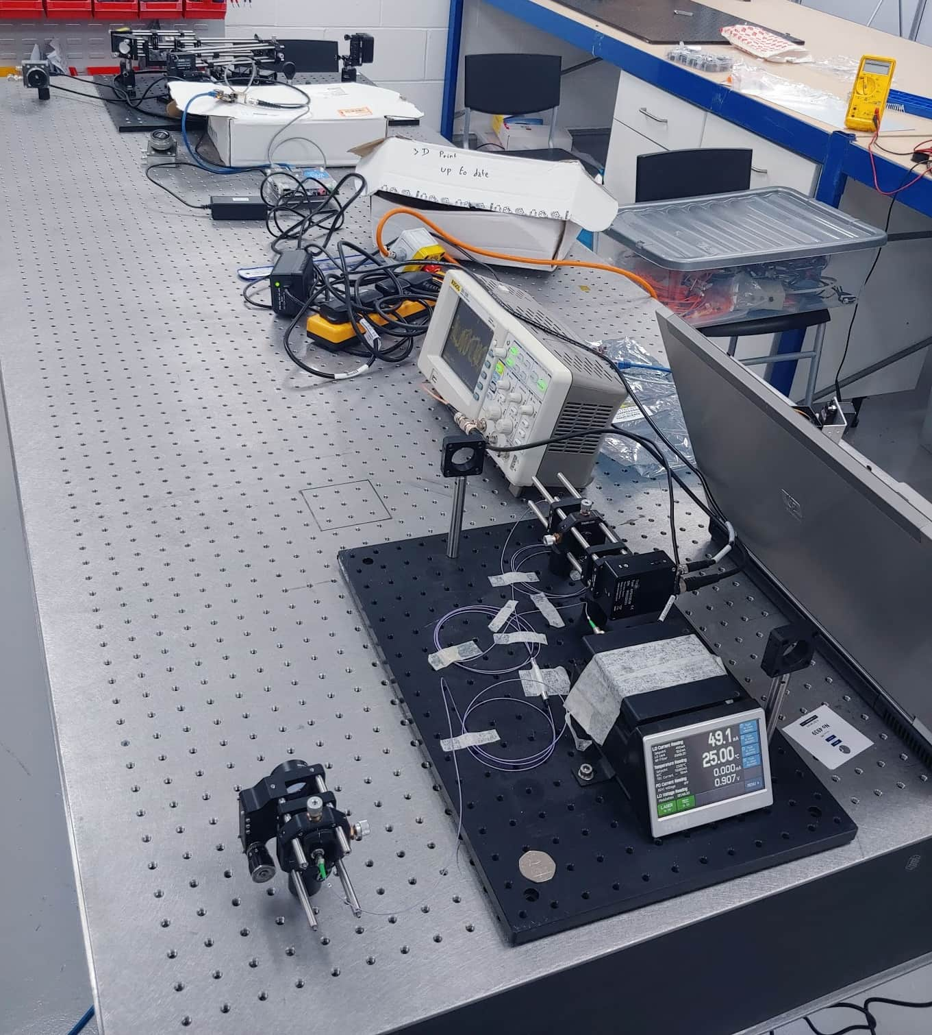
Free Space Optics
Free Space Optical communications for a variety of applications
2023 © AVoptics Ltd. All rights reserved.

Slide 22

ADVANTAGES OF FSO
2023 © AVoptics Ltd. All rights reserved.
HIGH DATA-RATE
UNCONGESTED SPECTRUM
UNLICENSED SPECTRUM
DIFFICULT TO DETECT
DIFFICULT TO JAM / SPOOF
RESILIENT TO E.M. INTERFERENCE + RF ‘QUIET’
2023 © AVoptics Ltd. All rights reserved.

Slide 23
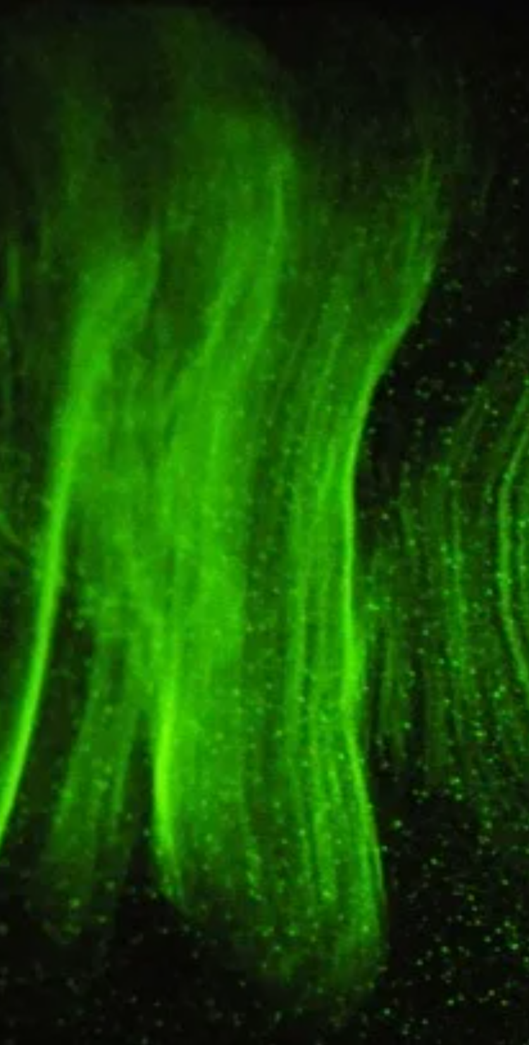
CHALLENGES OF FSO
2023 © AVoptics Ltd. All rights reserved.
ALIGNMENT AND SETUP
OBSCURATION
ATMOSPHERIC CONDITIONS
EYE SAFETY
DYNAMIC SYSTEMS ARE CHALLENGING

Slide 24
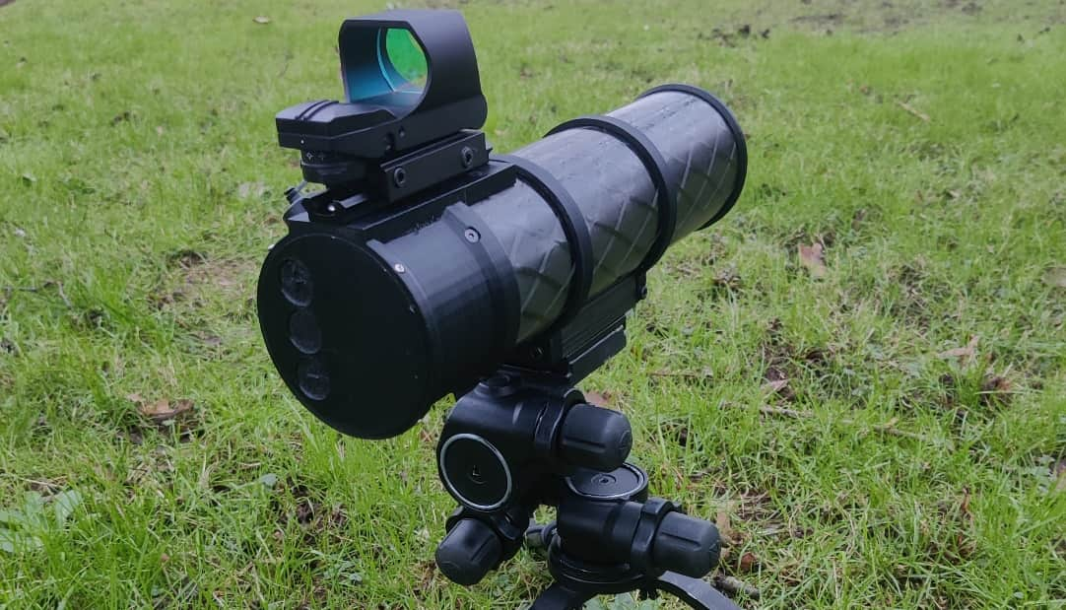

AVOPTICS FSO TECHNOLOGIES
WOLF
FIELD PORTABLE 1GBPS BI-DIRECTIONAL FSO
GALAHAD
MODULATED RETRO REFLECTOR
Copyright © 2023 AVoptics Limited

Slide 25



Development Applications

Slide 26


Fibre-Optics for the Harshest,
Most Demanding Environments

